Slide 1
Analog Gauge Reading Using CNN Regression
A Deep Learning Approach for Automated Gauge Reading using CNN regression
Guy Dahan
Advisor: Doron Oizerovich
Tel Aviv University | Captain’s Eye

Slide 2
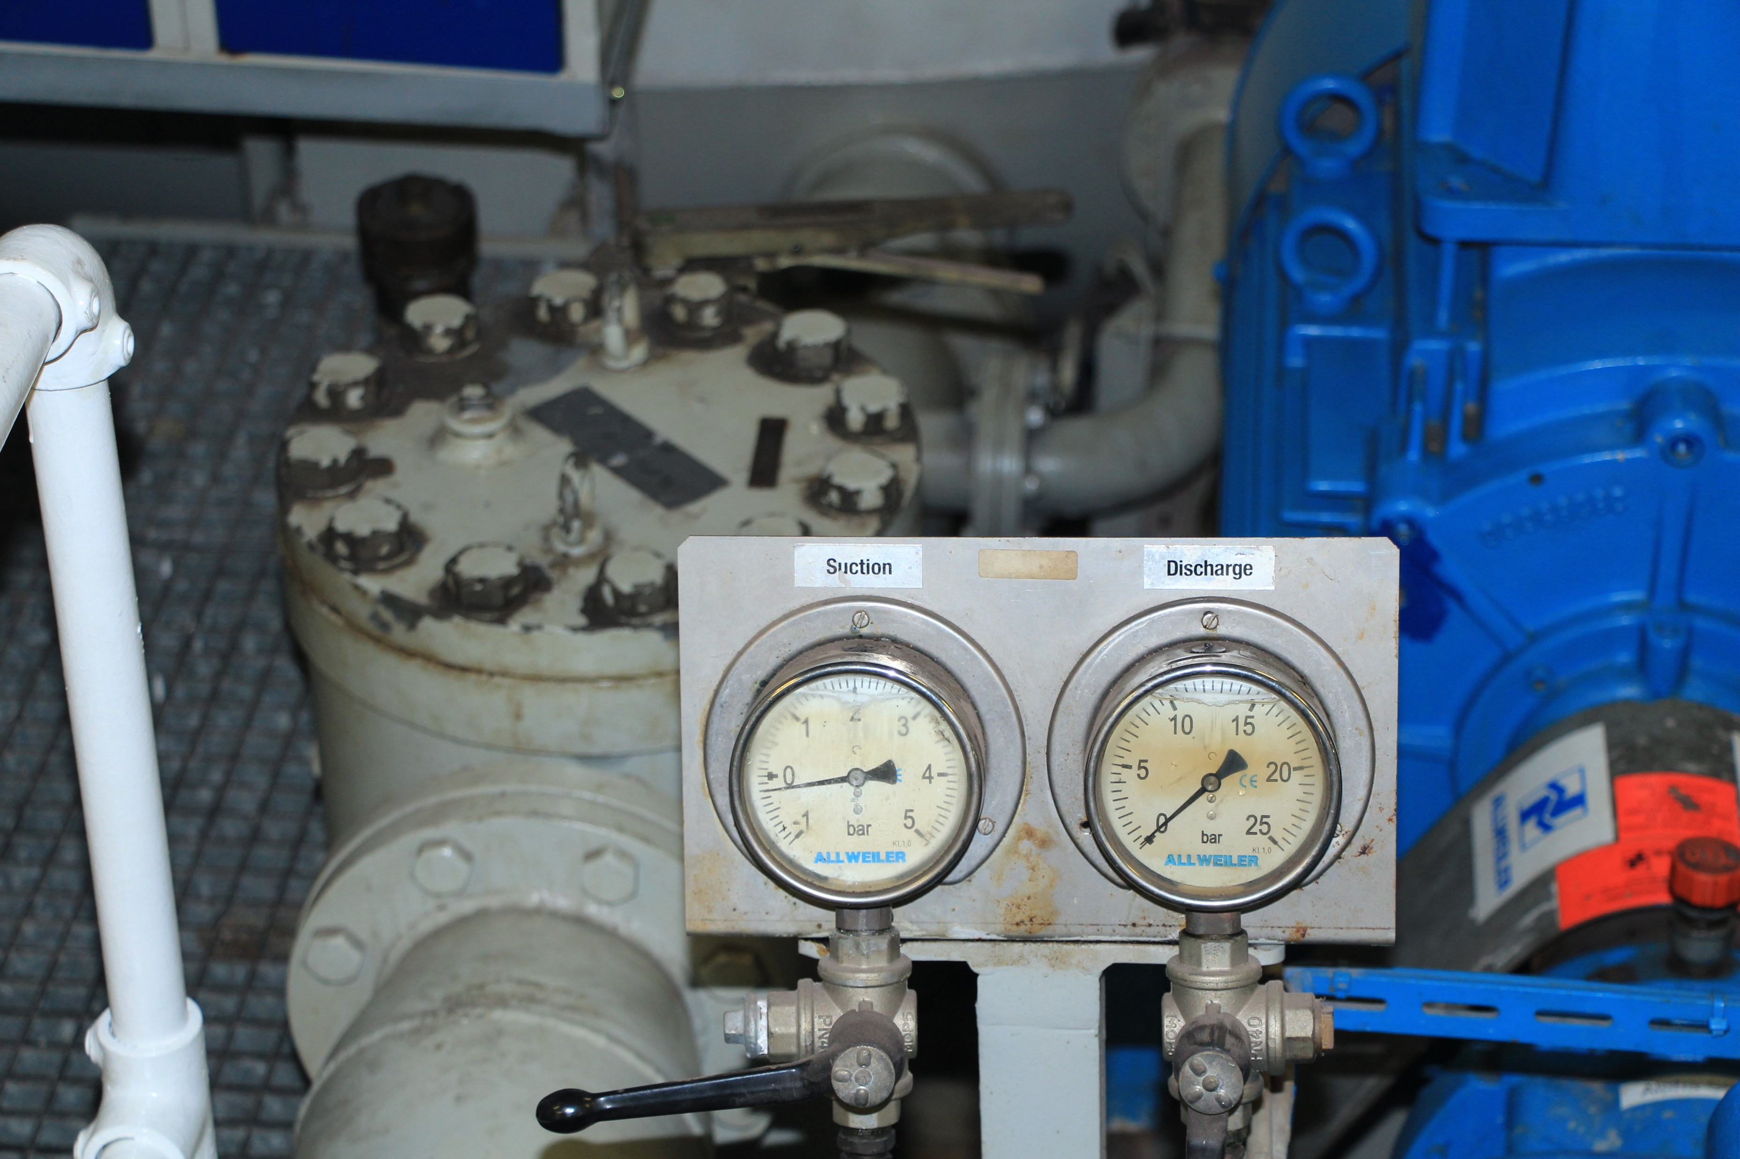
Introduction

Slide 3
The Problem
Challenges | Objectives
An analog gauge installed onboard a ship cannot supply training images | Use synthetic data to create train, validation and test sets
The calibration process must be easy and quick | Create a custom, specific and light UI for calibration
Model must be light and optimized | Create a custom and optimized CNN model

Slide 4
Methods
Light Custom UI
Image editing
1 image only
Training the Model
150 epochs
MSE Loss
Test and Save
weights.pt file and XML calibration
Pytorch CNN custom model

Slide 5
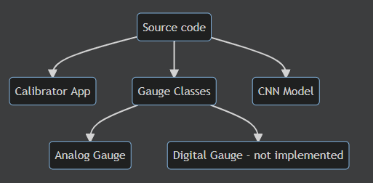
The Project

Slide 6
Usage
Calibration
Training
Reading

Slide 7
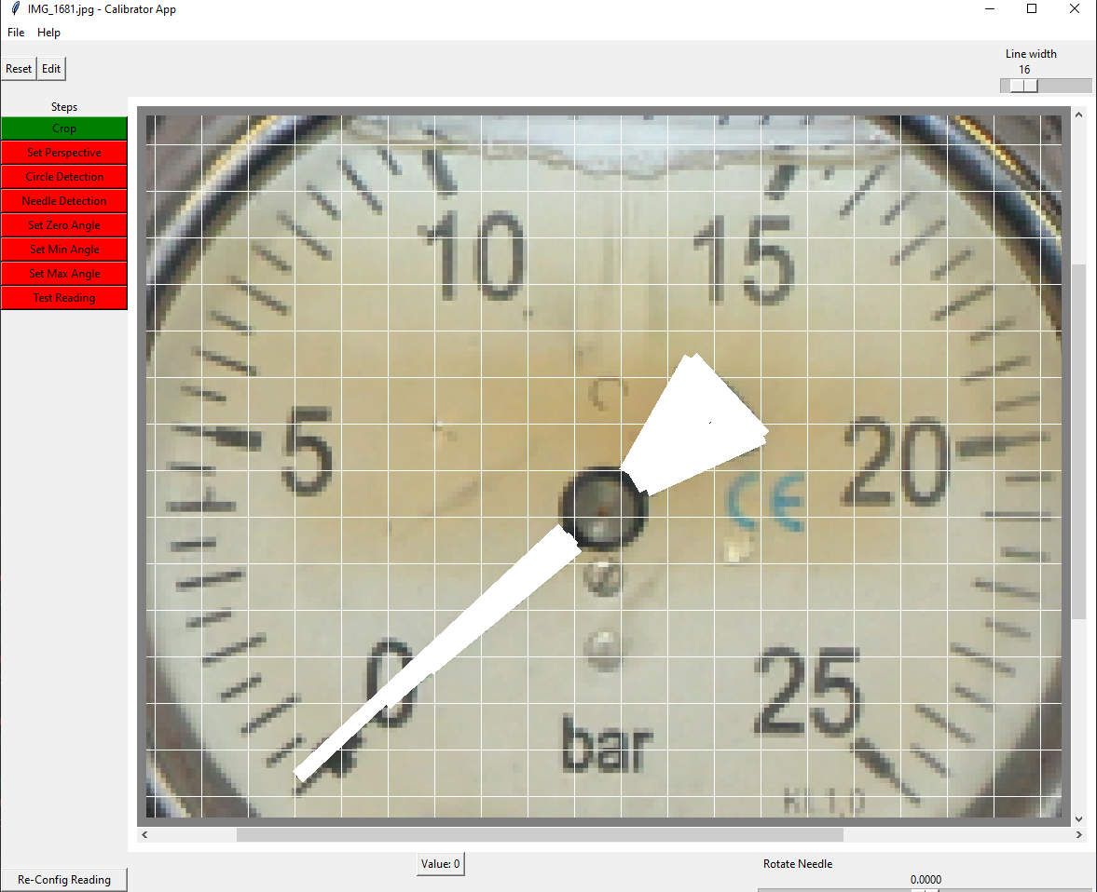
Calibration App
A full UI designed from scratch
Fast
Cross platform (Windows 10, Windows 11, Linux)
Versatile
Full of features

Slide 8
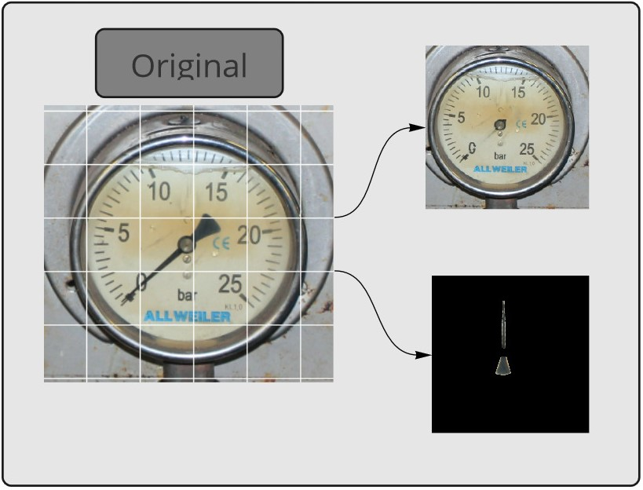
Synthetic Data

Slide 9
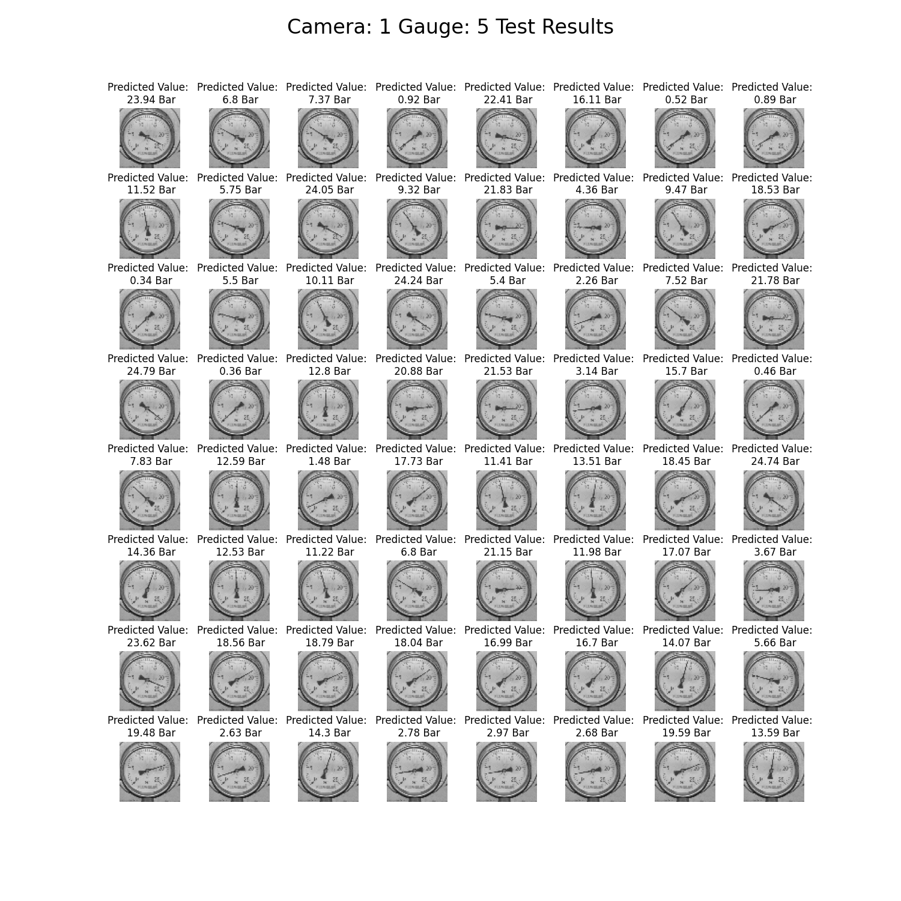
Synthetic Data
Train, Test and Validation sets – all from 1 picture!
Automatic report for visual test
Data is also augmented to enhance training

Slide 10

The Model
CNN
Weight initialization using Xavier Uniform
Automatic Epoch Adding and Choosing
MSE Loss
Automatic training reports

Slide 11
The Code
PEP8
OOP principles
Documentation
Simplicity
Version control - GIT

Slide 12
Demo
A full walkthrough

Slide 13
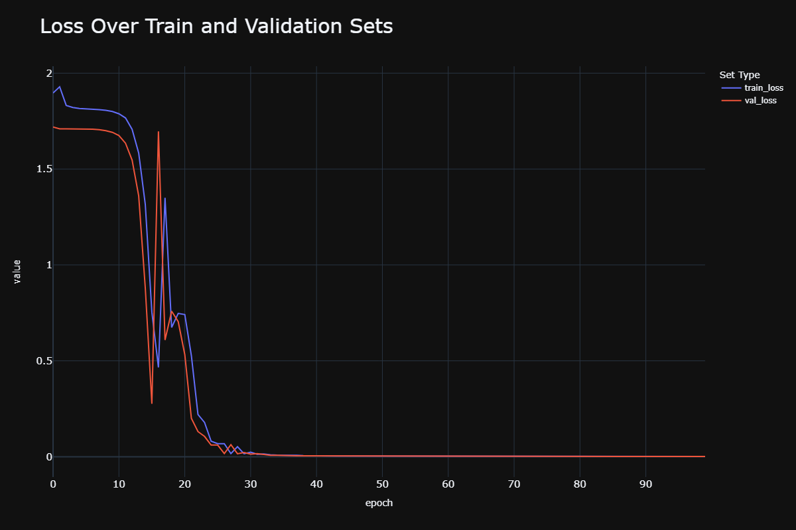
Results

Slide 14
Conclusions
Reading the gauges using the synthetic data is feasible
The process is light and quick
Future improvements: Augmentation, digital gauges reading

Slide 15
Uses
Ships
Ports
Industrial
Medical

Slide 16
Potential Improvements
Testing Framework
Replace TKinter with PyQt5
Circle Detection
Unit Detection
Python 3.10.4
Gauge Detection
Logging

Slide 17
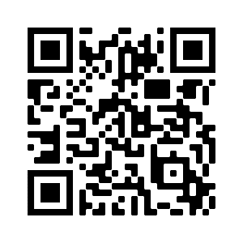
Thank you!
Guy Dahan

